Slide 1
ADSP 31009/IP03 [44148] Machine Learning & Predictive Analytics
Christopher Marasco
Good deal or bad?
A neural network regression model predicting wine prices and helping guide your wine-buying decisions
May 20th, 2024
Notes:
https://www.vantagemarketresearch.com/industry-report/wine-market-1558#:~:text=Snapshot&text=Market%20Synopsis%3A,5.90%25%20over%20the%20forecast%20period.

Slide 2
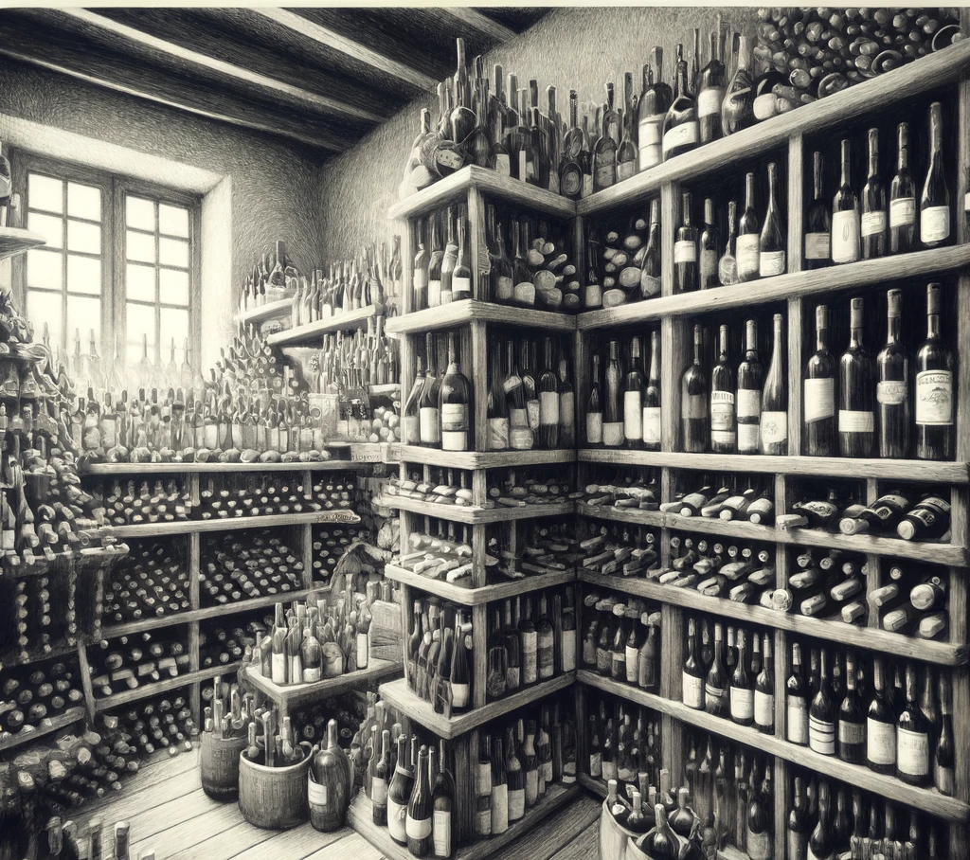

The reason we’re here: Problem Statement
Executive Summary:
The wine industry is a crowded market. Just ask yourself how easy it was to navigate your local grocer’s section let alone a wholesaler’s aisles upon aisles.
The reason for this is obvious, it’s a 440+ billion-dollar global industry.
But with that crowding comes noise. We are here today to build a well-generalized deep learning model to help an average wine enthusiast buy good wine at good prices.
Notes:
https://www.google.com/search?q=how+big+is+the+global+wine+industry&rlz=1C5GCEM_enUS1090US1090&oq=how+big+is+the+global+wine+industry&gs_lcrp=EgZjaHJvbWUyBggAEEUYOdIBCDUwODVqMGo3qAIAsAIA&sourceid=chrome&ie=UTF-8

Slide 3

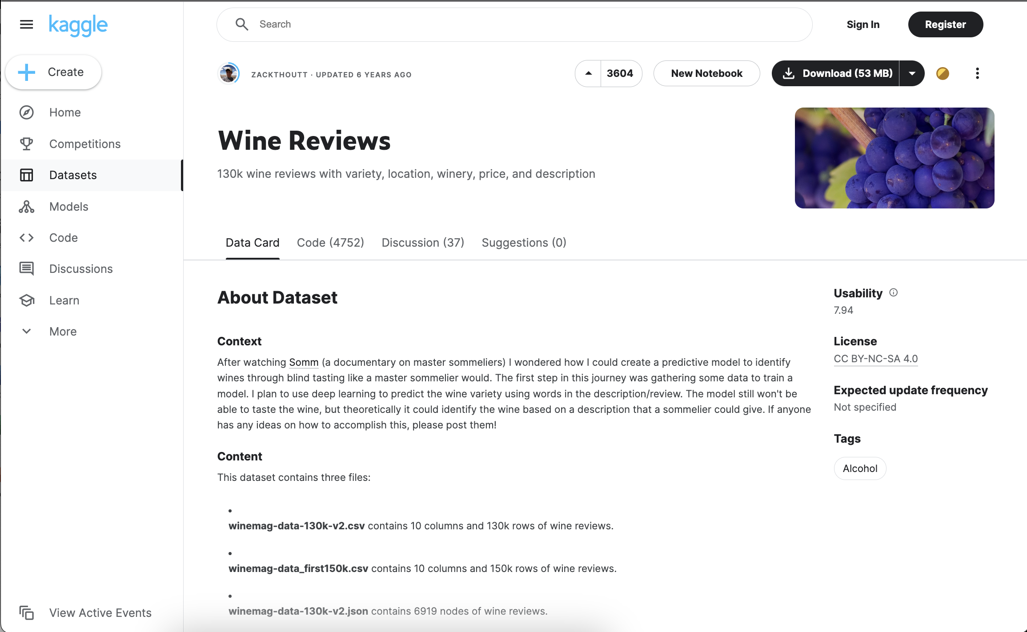
Assumptions, hypothesis, and data set
We pick up a thread from the Kaggle*
Our publisher wonders if we can build an ML model to predict wine varietals through blind-tasting (for a machine this would be leveraging text descriptors)
I chose to leverage the dataset, but tweak the hypothesis
I would rather, like to use the data to predict wine price, and when my model is fit enough, look for outliers that would indicate a good buy (or a bad)
The data was scraped from WineEnthusiast during the week of June 15th, 2017, so one incredibly huge assumption is that this data, though voluminous, is representative of a current market
* https://www.kaggle.com/datasets/zynicide/wine-reviews

Slide 4
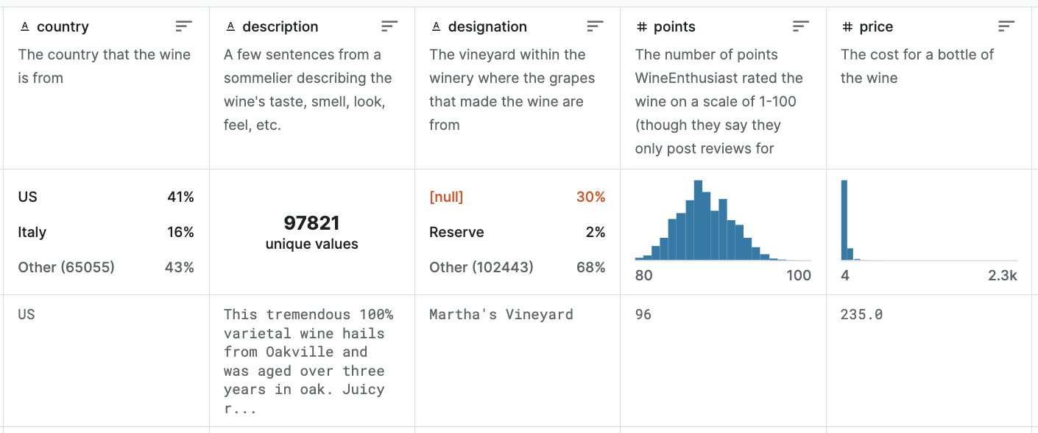
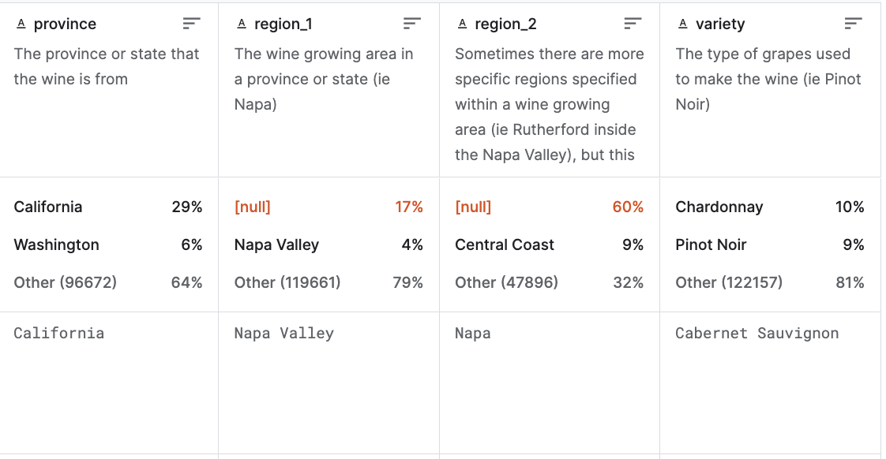
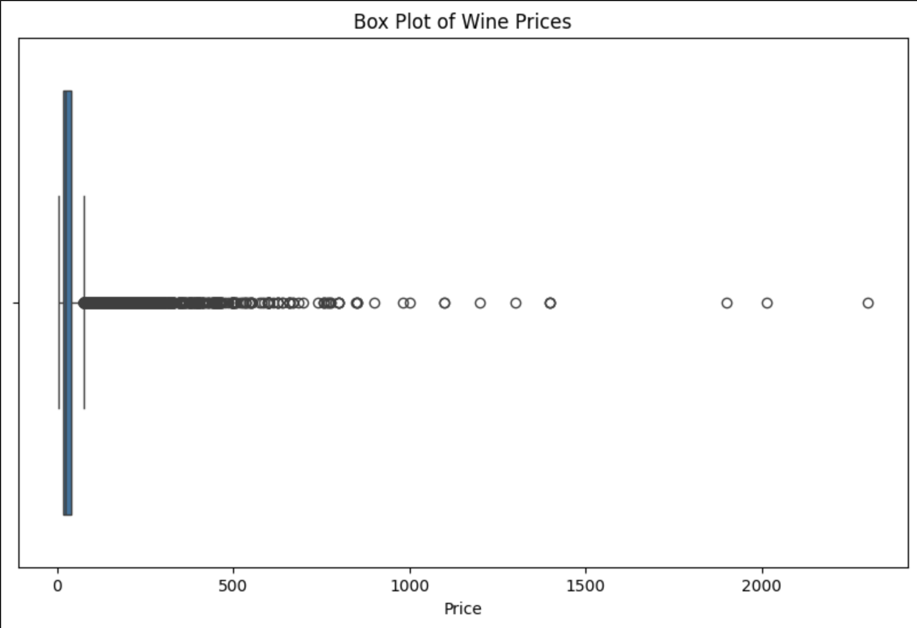
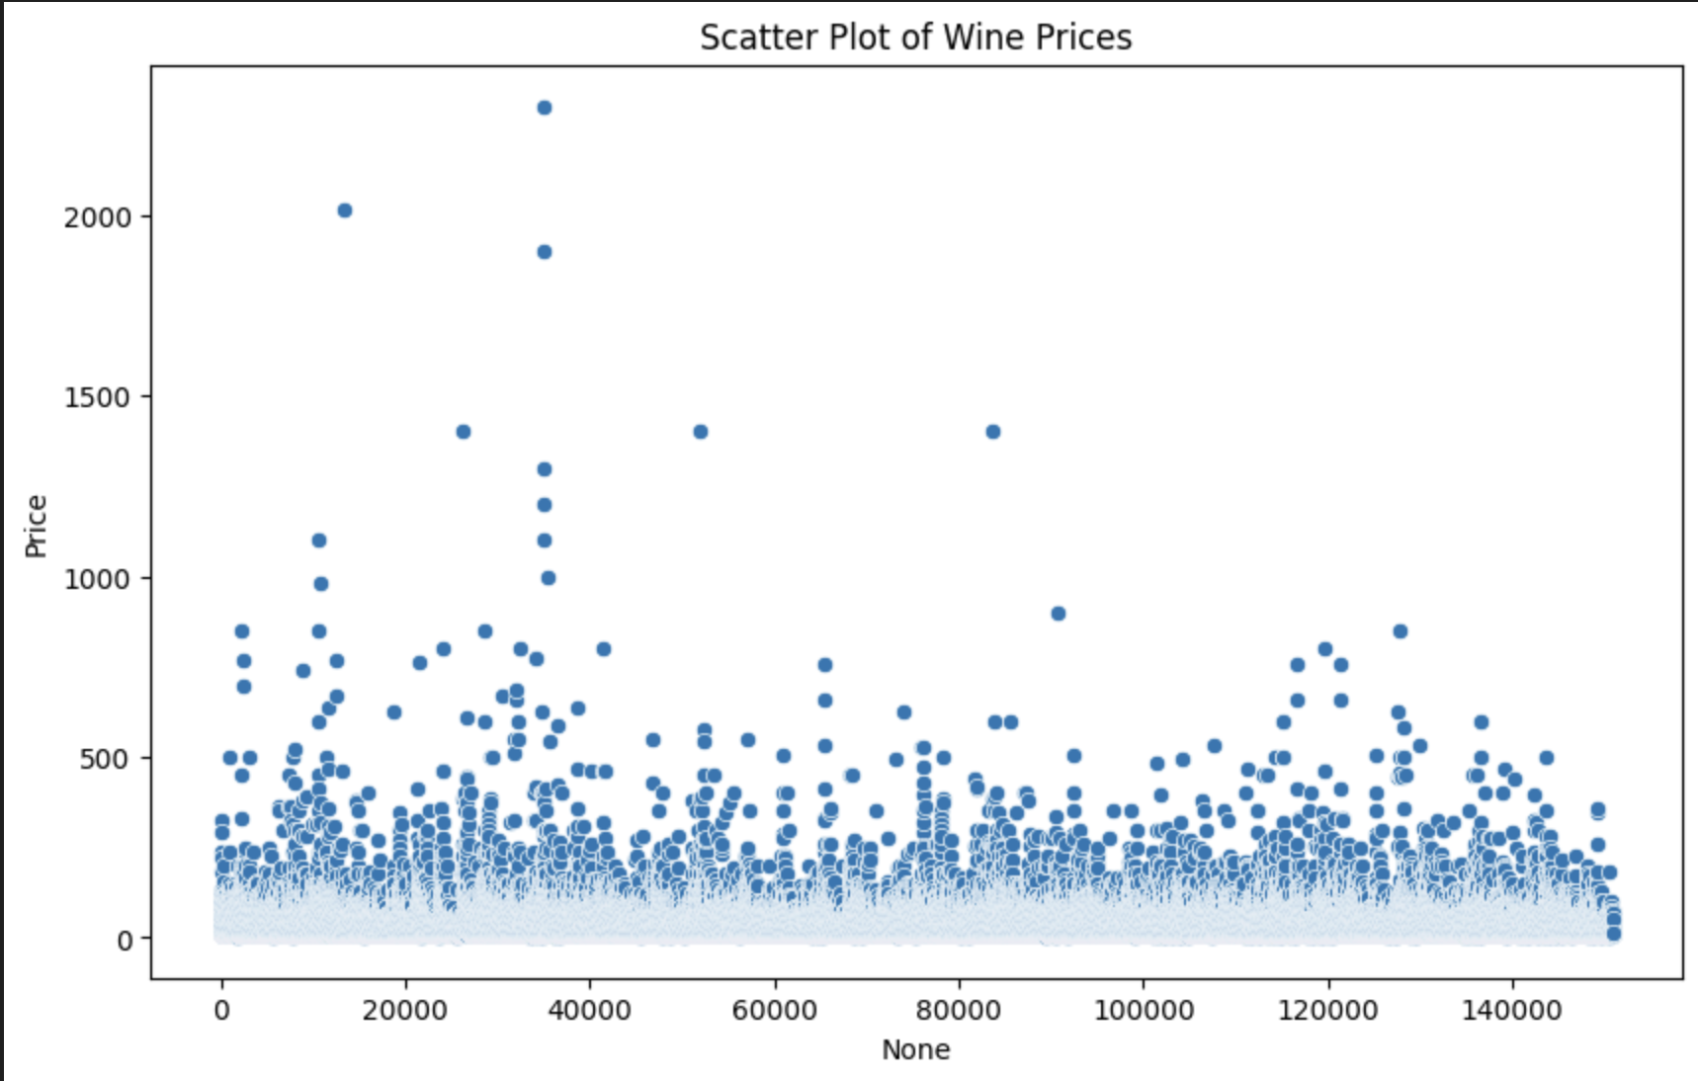
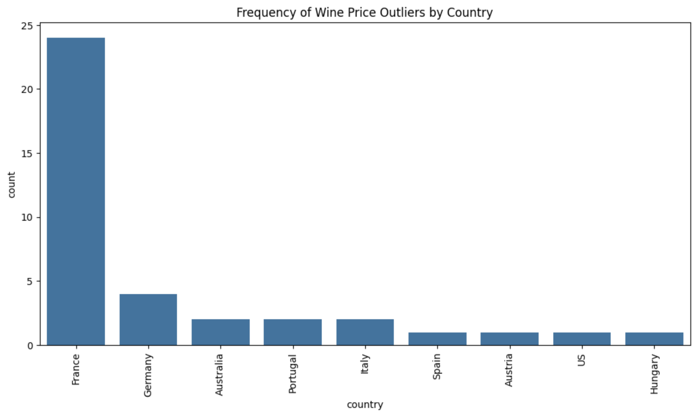
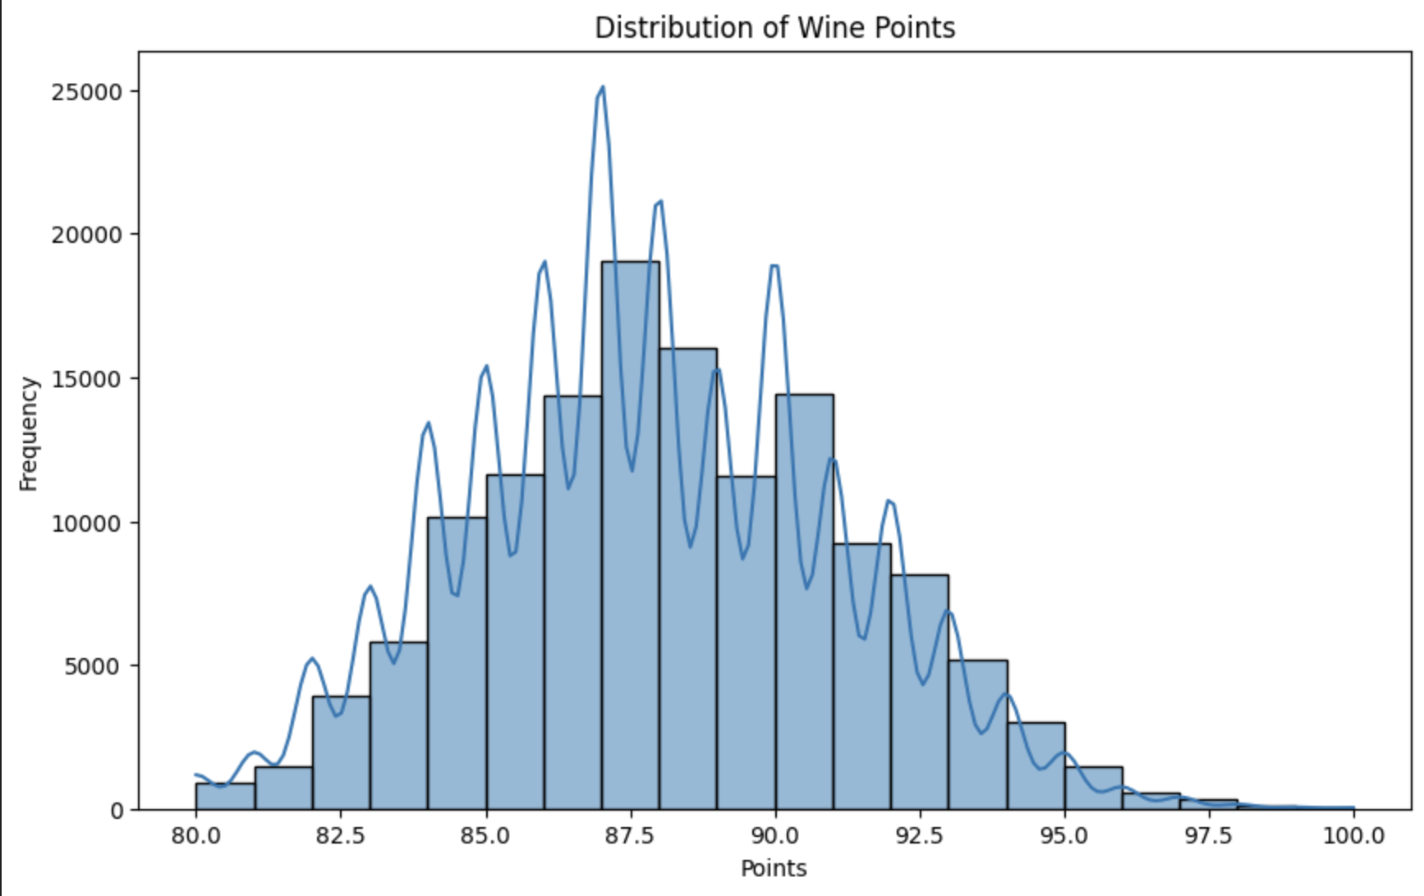
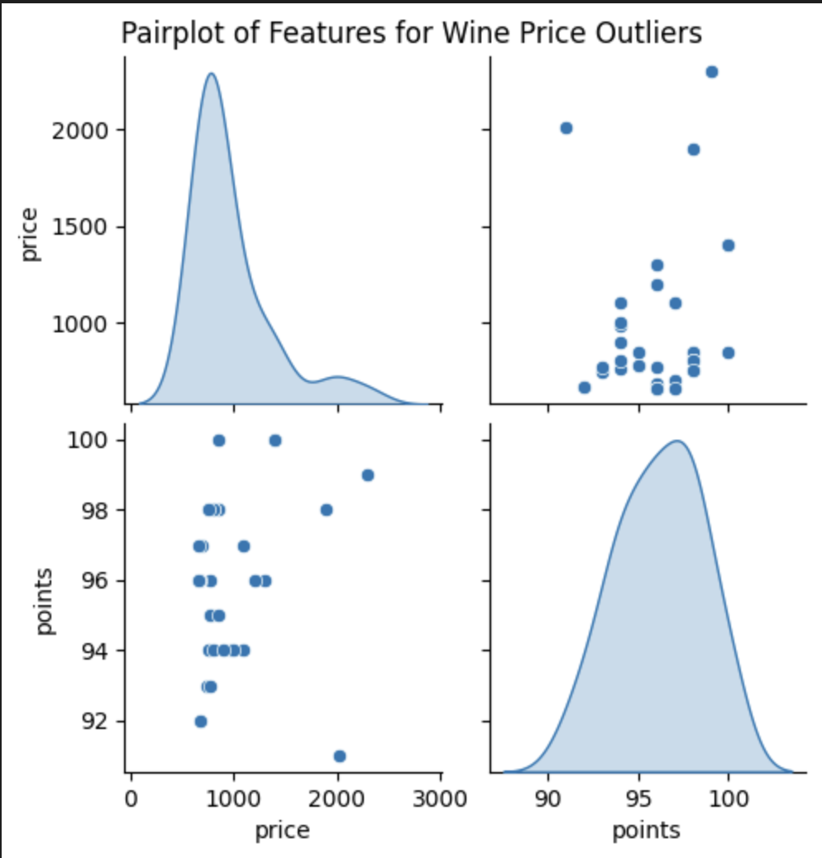
Exploratory Data Analysis
Apart from removing wasteful features, and dropping some outliers, our dataset is fairly complete and simplistic
A sample of our original dataset
We dropped ‘Description’ as irrelevant for my exercise and ‘designation’ as redundant. Despite many nulls in the region columns, we wanted to keep those for context if possible.
country
description
designation
Points
price
province
region_1
region_2
variety
-
-
-
-
-
-
-
A review of our predictor and feature set
Immediately we see outliers not be worth leveraging if we want a more generalized model and functional recommendation tool (novice wine buyers aren’t in market for $2000 Bordeaux)

Slide 5
Feature Engineering & Transformations
1
Encode our categorical data
2
Normalize our target ‘Price’
3
Split our data for train and test
Neural networks cannot work directly with categorical text data. They require numerical input.
We use Sklearns LabelEncoder to convert our strings to integer values
Fromsklearn.preprocessing import LabelEncoder, StandardScaler
We also need to normalize our target variable. Standardizing to improve model performance.
scaler =StandardScaler()
df['points'] = scaler.fit_transform(df[['points']])
Splitting the data allows us to train the model on one subset of the data and evaluate it on another subset to see how well it generalizes to unseen data.
X_train, X_test, y_train, y_test = train_test_split(X, y, test_size=0.2, random_state=42)

Slide 6


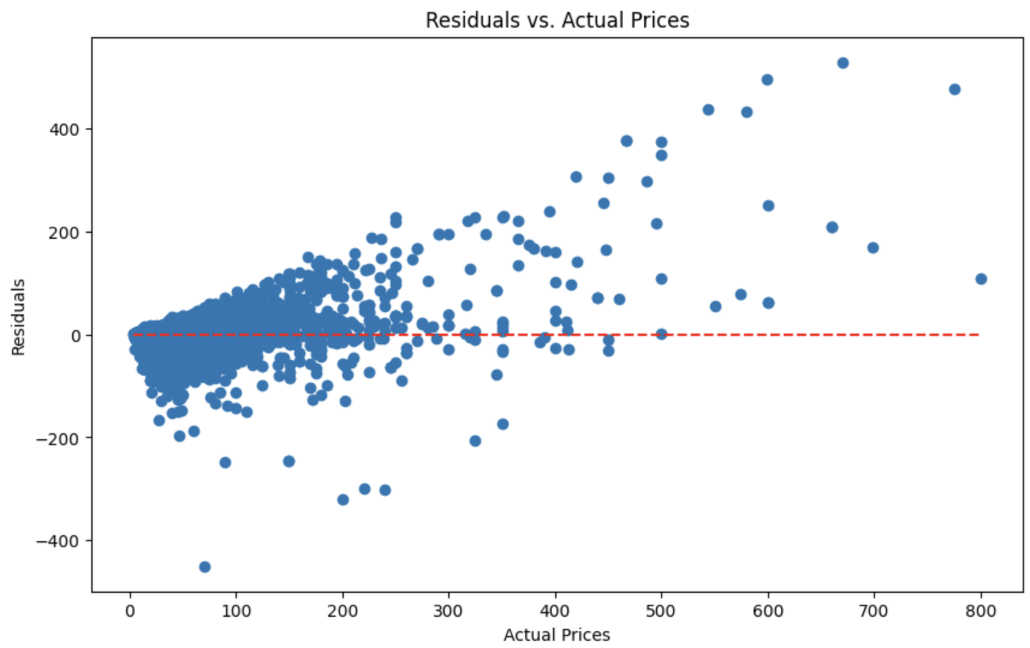
Model approach and fit
5: Model Fit
Visually we’re having a hard time with the higher priced wins, where we clearly see strong residual spread
1: We chose to use Keras to generate our neural network because of it’s
Ease of Use /User-Friendly API
Integration with TensorFlow
Flexibility:
Extensive Documentation and Community Support:
3: Compile our model
Both input and output layers are complied with our objective function set to minimize our mean squared error
2: Fully Connected neurons
We used two fully connected (Dense) layers with normalization and a dropout rate applied to each
At each neuron we add a ReLU activation function to introduce some non-linearity
4: Run the model
We added a validation split of 20%
Ran 50 epochs
on a batch of 32
Mean Absolute Error (MAE): 7.186
Mean Squared Error (MSE): 327.306
Root Mean Squared Error (RMSE): 18.092
R-squared: 0.726

Slide 7
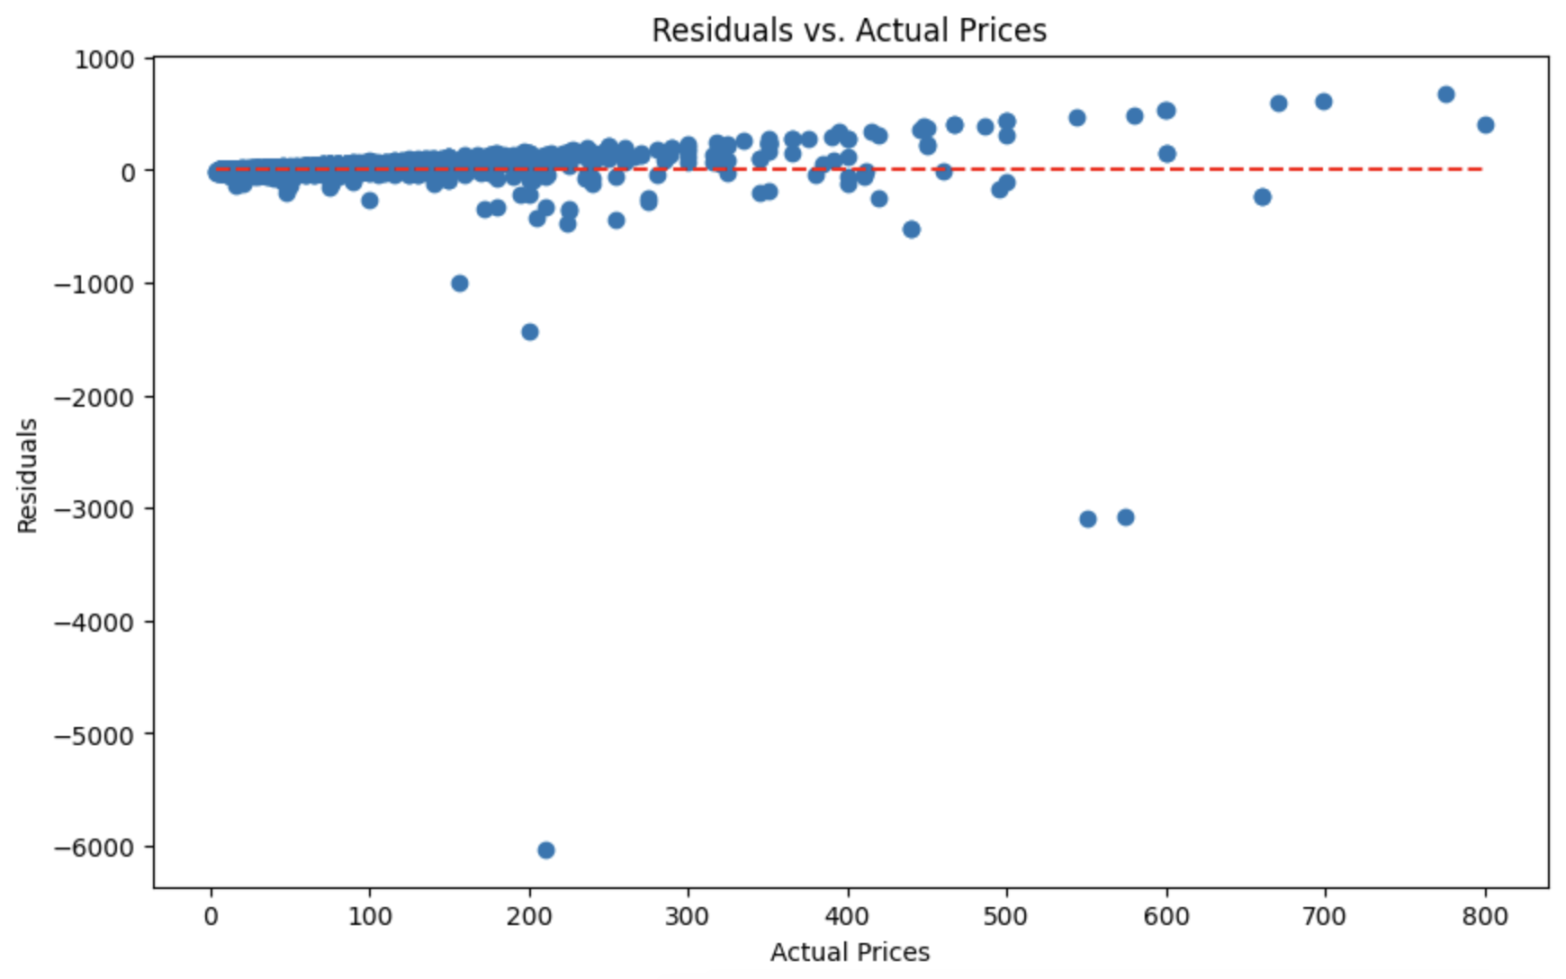
Results and Learnings
Following our baseline model we ran Optuna to hyper-tune our parameters based on the below
optimizer: Chooses between 'adam' and 'rmsprop’.
neurons: Chooses an integer between 64 and 256.
dropout_rate: Chooses a float between 0.3 and 0.7.
Despite some of the anomalies which visually “squash” our plot, on all accuracy dimensions, our hyper-tuned model under-performed our baseline model
Baseline Model (Champion)
Hyper-Tuned Model
Mean Absolute Error (MAE): 7.186
Mean Squared Error (MSE): 327.306
Root Mean Squared Error (RMSE): 18.092
R-squared: 0.726
Mean Absolute Error (MAE): 10.239
Mean Squared Error (MSE): 2669.435
Root Mean Squared Error (RMSE): 51.667
R-squared: -1.230

Slide 8
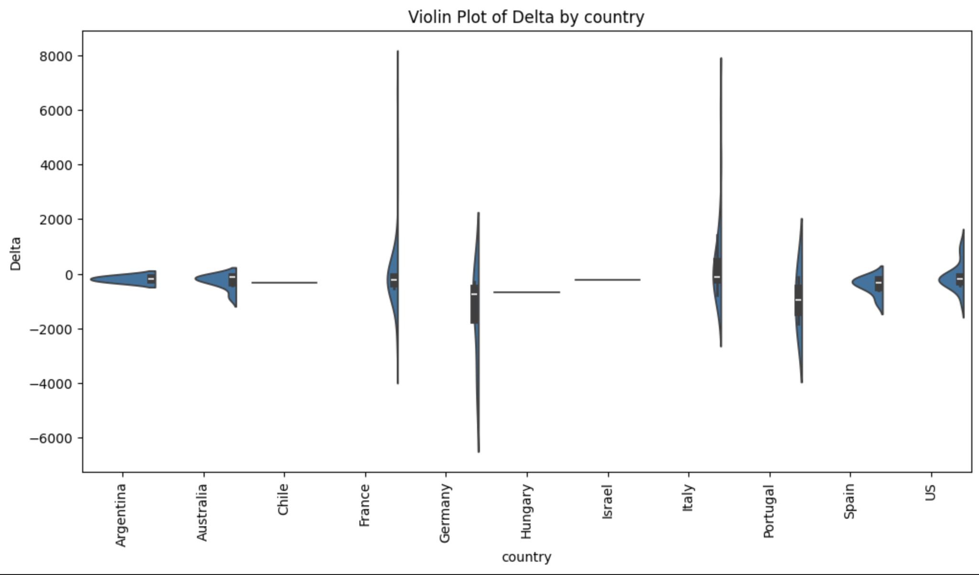
So what’s a good buy?
We attempted to normalize our results for objectivity ‘Average’
From a pure volume game, we have a lot of good buys in the French and Italian producers
Albania, however, based on capping our data frame to the less expensive wins, is showing the greatest single opportunity for savings!
country | Actual Price | Predicted Price | Delta | Wine count | Average
Albania | $20.00 | $84.10 | $64.10 | 1 | $64.10
France | $3,818.00 | $5,376.08 | $1,558.08 | 26 | $59.93
Lebanon | $50.00 | $166.37 | $116.37 | 2 | $58.18
Italy | $1,536.00 | $2,452.73 | $916.73 | 16 | $57.30
Brazil | $15.00 | $66.19 | $51.19 | 1 | $51.19
Chile | $101.00 | $252.65 | $151.65 | 3 | $50.55
US | $1,251.00 | $2,222.19 | $971.19 | 20 | $48.56
Australia | $55.00 | $197.58 | $142.58 | 3 | $47.53
Spain | $202.00 | $432.84 | $230.84 | 5 | $46.17
Germany | $100.00 | $326.62 | $226.62 | 5 | $45.32
Japan | $24.00 | $69.14 | $45.14 | 1 | $45.14
Hungary | $25.00 | $66.68 | $41.68 | 1 | $41.68
Argentina | $66.00 | $107.58 | $41.58 | 1 | $41.58

Slide 9
Future Work
1
More, smarter feature selection
Features like region 2, which had upwards of 60% Null
2
Target variable bin segmentation
Because of the excessive increase in residuals as the price points of the wine get higher, I think it might be best if we break the model down into ”higher” and “lower” price points
3
Hyper-parameter tuning, tuning
Work out where in my hyper parameter tuning we fell apart (e.g. instead of using RMSProp and Adam as optimizers, I could have toggled between ReLU or GeLU
4
“Good buy” bin segmentation
Break down “good buy” by price point with unique thresholds
5
Try a different model!
;alksjd;flakjsdf;lkajsd;flkj

Slide 10
THANK YOU

